Slide 1
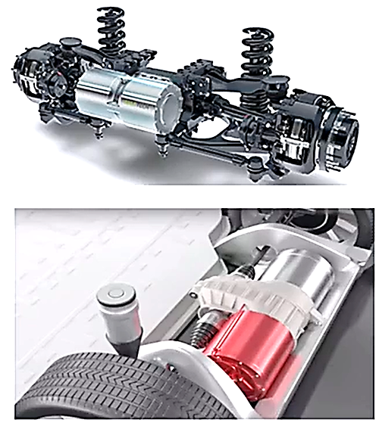
Motors
What powers an Electric Car?
Built for power, speed and efficiency.
An electrical machine that converts electrical energy into mechanical energy.
They be powered by direct current (DC) sources, such as from batteries, motor vehicles or rectifiers, or by alternating current (AC) sources, such as a power grid, inverters or electrical generators.
They are magnetic drives.

Slide 2
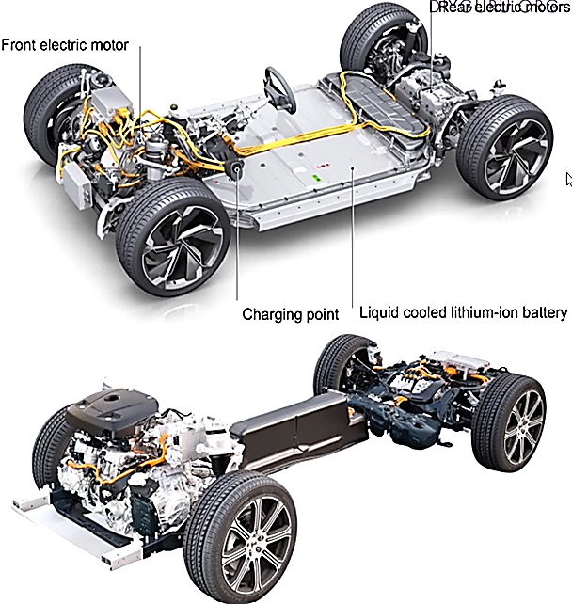
Why Electric Motors are better ?
Few moving parts
Easier to maintain and cheaper
For adjusting speed, adjust the frequency of current
Speed range is from O to 20,000 RPM
No transmission required
Small in size, we can use 2 motors in once car
Full torque at 0 speed
No sound until the pedal is pressed to floor
More efficient that Internal combustion engines

